Slide 1
Guide to Data and Information Sharing Workflows Across the Life Cycle of Transportation Assets
May 12, 2016

Slide 2
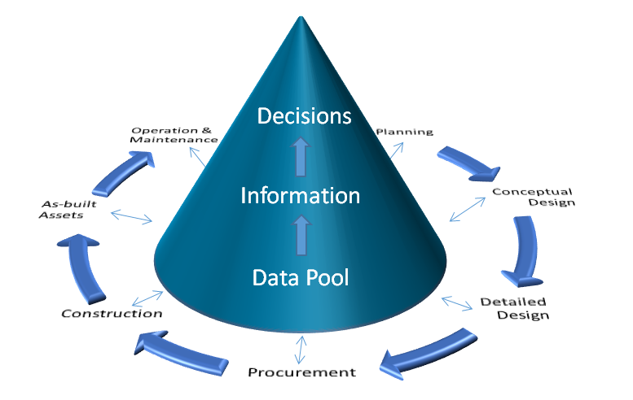
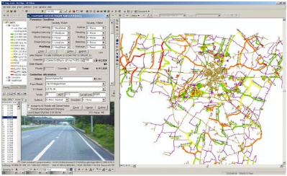
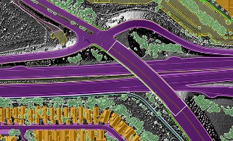

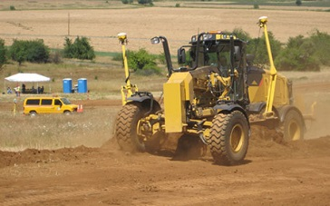
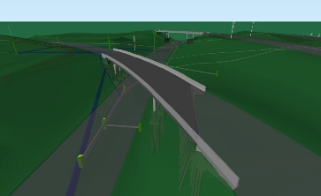
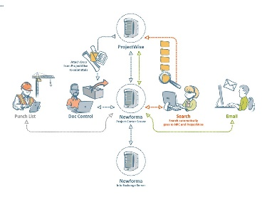
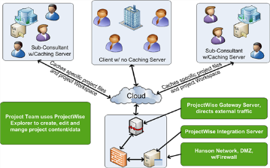
Research Vision – better, faster, smarter

Slide 3
Data – Information - Decision

Slide 4
Research Goals
Develop a guide to facilitate the digital data and information flow during the project life-cycle for various type of transportation assets including pavements, bridges, culverts, signs, guardrails, etc.
Data and Information delivery maps and manuals
Business workflow processes that facilitate seamless data and information flow across departments and throughout asset’s life cycle
Data requirements, data sources, levels of detail, software applications and tools involved in specific data exchange use cases.

Slide 5
Work Tasks
Task 1: Literature review and benchmark the building industry practices
Task 2: Identify business use case narratives and develop process maps
Task 3: Identify data exchange requirements and develop data maps
Task 4: Develop a guide to data and information sharing
Task 5: Final report writing

Slide 6
Task 1-Literature Review / Benchmark the vertical industry
Review publications associated with best practices and lessons learned in data sharing in the vertical industry.
Extensively study the Information Delivery Manual (IDM).
Identify possible areas of adaptations for the civil infrastructure industry.
→ Deliverable: A technical memorandum

Slide 7
Task 2-Identify business use case narratives and develop process maps
Form workgroup including industry professionals from various disciplines and project phases.
Identify business use cases in which data sharing would occur.
Describe use case narratives in details (actors involved, activities, software applications, project phases, purposes of activities, anticipated outcome).
Translate narratives to process maps using Social Network and/or Business Process Modeling Notation (MPMN).
→ Deliverables: business use case narratives and process maps

Slide 8
Task 3-Identify data exchange requirements and develop data maps
Continue to use focus group discussion
Identify exchange requirements (ERs) for each business use case
Describe ERs in details (data requester, provider, what data attributes, request rationale).
Integrate ERs into Process Maps to develop data sharing maps
→ Deliverables: data exchange requirements and data maps

Slide 9
Tasks 4 and 5-Develop a guide and prepare a final report
Develop a guidance for DOTs on data sharing during the life cycle of transportation assets.
Hold a workshop/seminar to disseminate the project findings.
Develop a final report documenting the research results.
→ Deliverables: A guidebook and a final report.

Slide 10
Research Schedule
Work Tasks | 2016 |  |  | 2017
 | Jul Aug | Sep Oct | Nov Dec | Jan Feb | Mar Apr | May Jun | Jul Aug | Sep Oct | Nov Dec
Task 1
Task 2
Task 3
Task 4
Task 5

Slide 11
Data sharing guidance in the vertical sector
Information Delivery Manual (IDM)

Slide 12
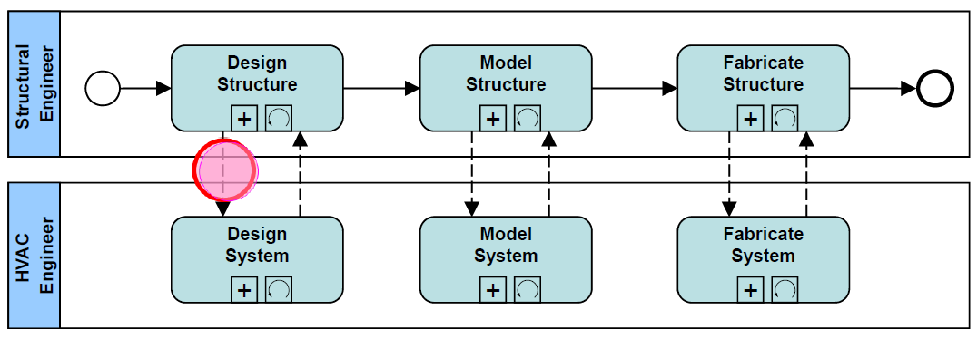
Process Map
A process map describes:
Tasks (activities) to be performed.
Sequencing of tasks.
Actors (people/organizations) involved.

Slide 13
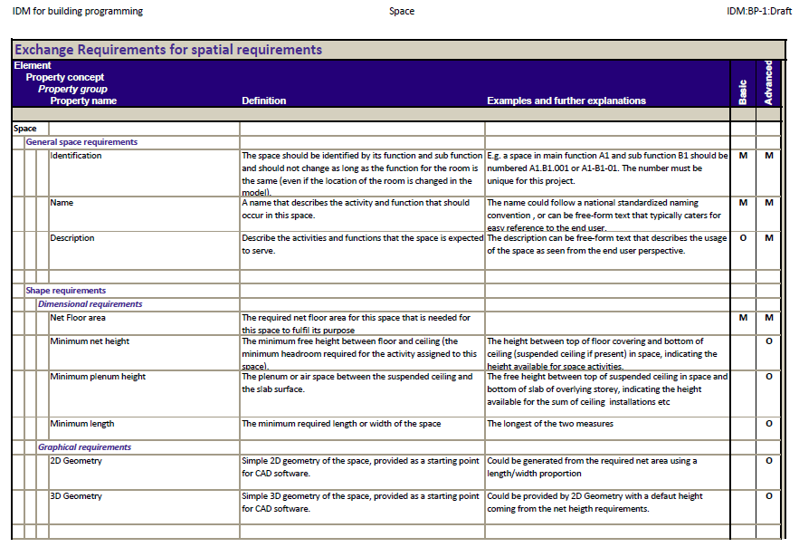
Exchange Requirement (ER)
ER defines what data/information to be shared.
Audience is the user (architect, engineer, constructor, etc.)

Slide 14
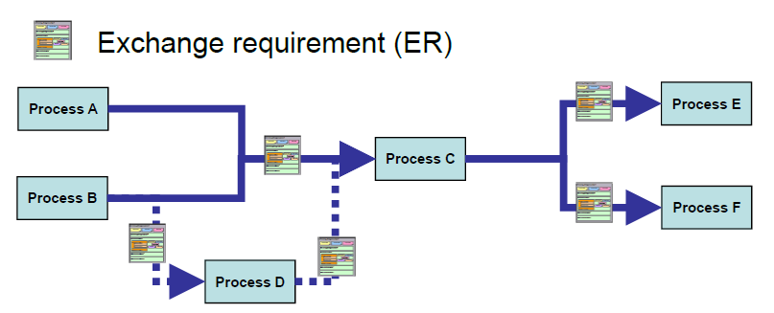
IDM-ER in Process Map
This is an integrated map of process and exchange requirements,
This map shows what data to be shared to whom and when.

Slide 15
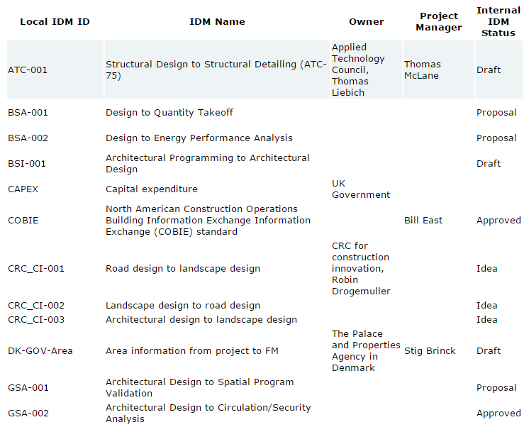
Overview of IDM Projects
04 Approved
01 Under review
12 Draft
18 Work in progress
06 Proposal

Slide 16
Current workflows for Civil Infrastructure Assets

Slide 17
Culvert workflow
Pre-construction survey
Construction survey
Surveyor
1
Designer
Cross-section design
2
5
Flow line design
3
Hydraulics
Contractor
4
Installation
1
Survey data
Locates of existing culverts
Locations of draw
2
Survey data
Design cross-section
3
Flow lines
4
Survey data
Storm sewer
5
Adjustments

Slide 18
Guardrail workflow
Prelim survey
Surveyor
1
Designer
Replacement decision making
2
Installation
3
Contractor
Inspector
4
Inspection
1
Map of what exist
Goepack files
Microstation line work
2
Guardrail type
Length, location, stationing, etc.
Microstation files
3
4
Guardrail condition
Sta references, locations, site time, contract progress, material

Slide 19
Discussions
Iowa DOT’s expectations ?
Involvement of software vendors ?

